Slide 1
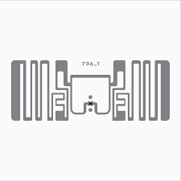
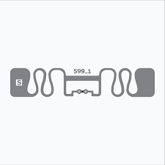
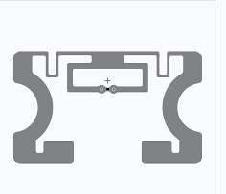
RFID inlays/labels for retails and similar applications
Aether Adept-4518
Key Specifications
Chip: Impinj M730/M830
Frequency Band: UHF (860-960)
Dimensions: 45 x 18 mm
Label Size : Customisable
EPC Memory: 128 bits TID Memory: 96-bit / 48-b
Aether Adept-7618
Key Specifications
Chip: Impinj M730/M830/U9
Frequency Band: UHF (860-960)
Dimensions: 45 x 18 mm
Label Size : Customisable
EPC Memory: 128 bits TID Memory: 96-bit / 48-b
Aether Adept-5030
Key Specifications
Chip: Impinj M730/M830/U9
Frequency Band: UHF (860-960)
Dimensions: 50 x 30 mm
Label Size : Customisable
EPC Memory: 128 bits TID Memory: 96-bit / 48-b
7042436155
www.aetherrfid.com

Slide 2
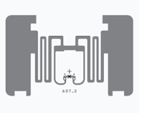
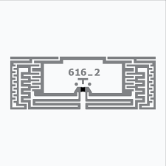
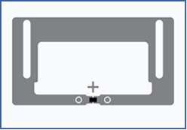
Aether Adept-5030-E
Key Specifications
Chip: Impinj M730/M830/U9
Frequency Band: UHF (860-960)
Dimensions: 50 x 30 mm
Label Size : Customisable
EPC Memory: 128 bits TID Memory: 96-bit / 48-b
-
Aether Adept-2212
Key Specifications
Chip: Impinj M730/M830/U9
Frequency Band: UHF (860-960)
Dimensions: 22 x 12 mm
Label Size : Customisable
EPC Memory: 128 bits TID Memory: 96-bit / 48-b
Aether Adept-2211
Key Specifications
Chip: Impinj M730/M830/U9
Frequency Band: UHF (860-960)
Dimensions: 22 x 11 mm
Label Size : Customisable
EPC Memory: 128 bits TID Memory: 96-bit / 48-b
7042436155
www.aetherrfid.com

Slide 3
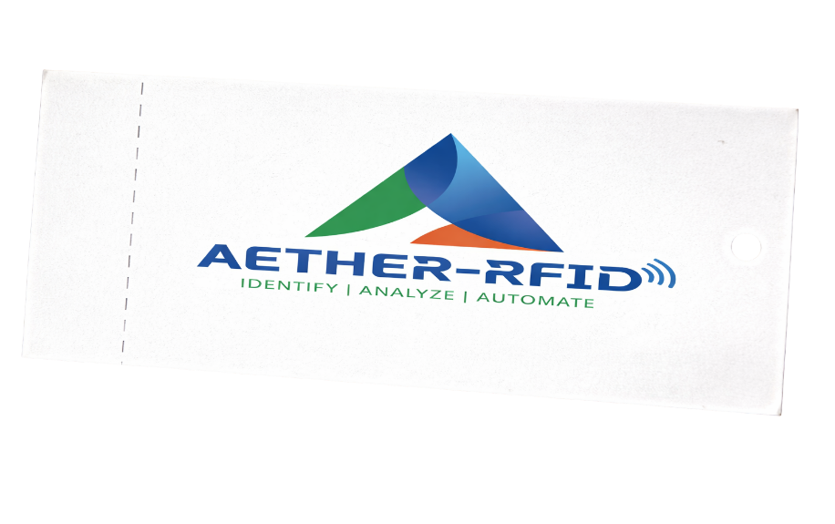
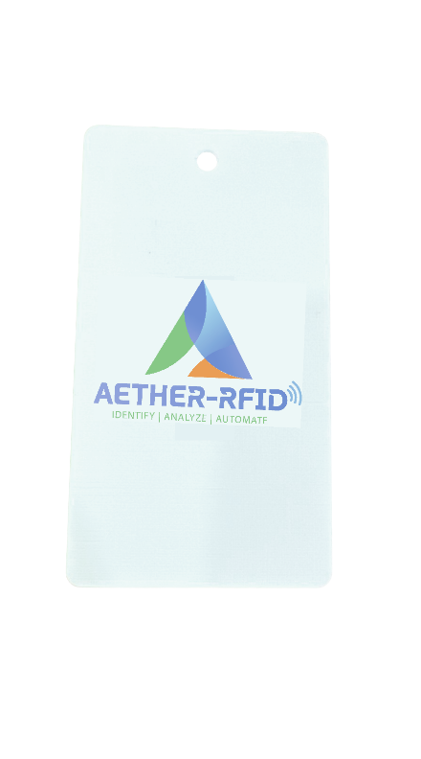
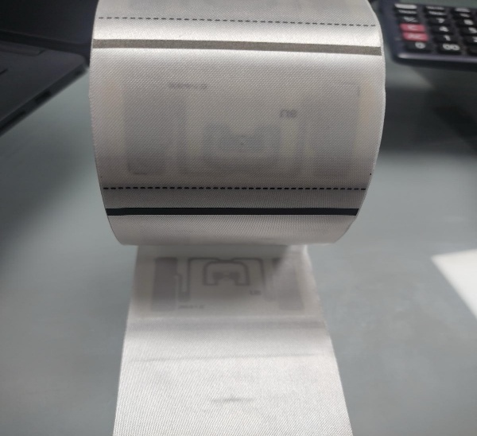
RFID Hang Tags & Taffeta Tags for Retail
Aether Outfit-6525
Key Specifications
Chip: Impinj M730/M830
Frequency Band: UHF (860-960)
Dimensions: 65 x 25 mm
Inlay Size : 45x18 mm
EPC Memory: 128 bits TID Memory: 96-bit / 48-b
Application : Apparels, Shoes
Aether Outfit-6525
Key Specifications
Chip: Impinj M730/M830
Frequency Band: UHF (860-960)
Dimensions: 65 x 25 mm
Inlay Size : 45x18 mm
EPC Memory: 128 bits TID Memory: 96-bit / 48-b
Application : Apparels, Shoes
Aether Outfit-6535
Key Specifications
Chip: Impinj M730/M830
Frequency Band: UHF (860-960)
Dimensions: 65 x 35 mm
Inlay Size : 50x30 mm
EPC Memory: 128 bits TID Memory: 96-bit / 48-b
Application : Apparels, Shoes
7042436155
www.aetherrfid.com

Slide 4
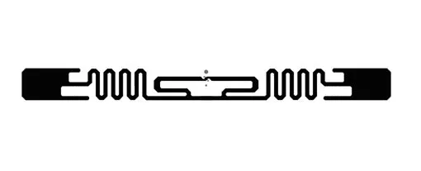
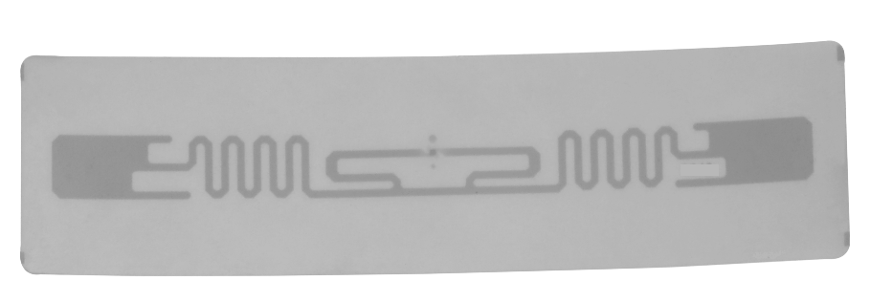
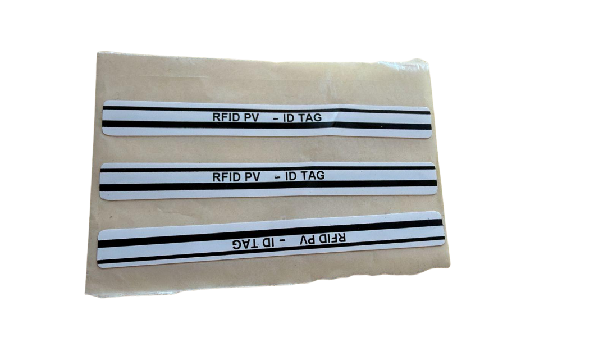
RFID inlays/labels for Solar applications
Aether Adept-9812
Key Specifications
Chip: Higgs 9
Frequency Band: UHF (860-960)
Dimensions: 98 x 12 mm
Label Size : Customisable
EPC Memory: 128 bits TID Memory: 96-bit / 48-b
Application : Solar
Aether Adept-9812 Label
Key Specifications
Chip: Higgs 9
Frequency Band: UHF (860-960)
Dimensions: 98 x 12 mm
Label Size : Customisable
EPC Memory: 128 bits TID Memory: 96-bit / 48-b
Application : Solar
Aether Adept-9503
Key Specifications
Chip: Higgs 9
Frequency Band: UHF (860-960)
Dimensions: 95 x 3 mm
Label Size : Customisable
EPC Memory: 128 bits TID Memory: 96-bit / 48-b
Application : Solar
7042436155
www.aetherrfid.com

Slide 5

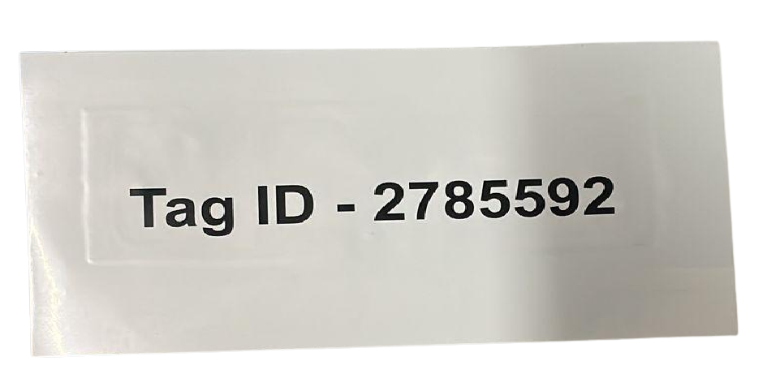
RFID inlays/labels for Windshield applications
Aether Traveler-9727
Key Specifications
Chip: G2iM/M730
Frequency Band: UHF (860-960)
Dimensions: 100 x 50 mm
Label Size : Customisable
EPC Memory: 128 bits TID Memory: 96-bit / 48-b
Application : Windshield
Printing : Multi colour
Encoding : Yes
Aether Traveler-10025
Key Specifications
Chip: G2iM/M730
Frequency Band: UHF (860-960)
Dimensions: 100 x 50 mm
Label Size : Customisable
EPC Memory: 128 bits TID Memory: 96-bit / 48-b
Application : Windshield
Printing : Multi colour
Encoding : Yes
7042436155
www.aetherrfid.com

Slide 6
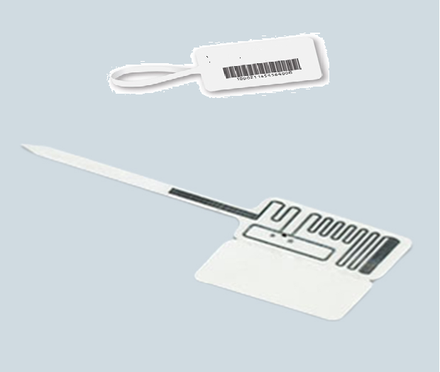
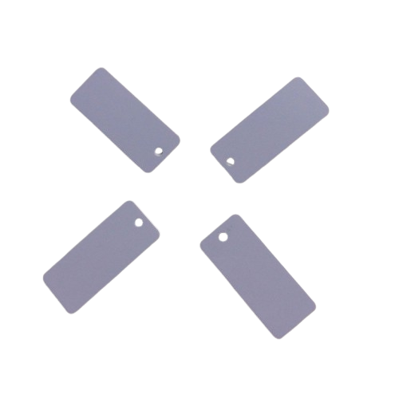
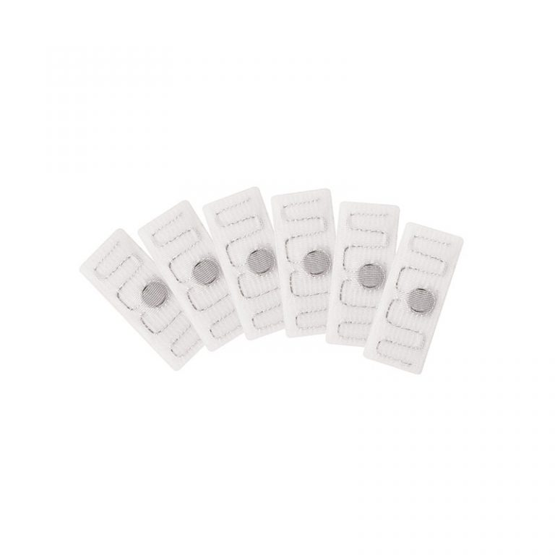
UHF RFID Jewellery & Laundry tags
Aether Regalia-5030
Key Specifications
Chip: Impinj M730/M830/U9
Frequency Band: UHF (860-960)
Dimensions: 60 x 18 mm
Label Size : Customisable
EPC Memory: 128 bits TID Memory: 96-bit / 48-b
Aether Regalia-4515
Key Specifications
Chip: Impinj M730/M830/U9
Frequency Band: UHF (860-960)
Dimensions: 45 x 15 mm
EPC Memory: 128 bits TID Memory: 96-bit / 48-b
Aether Rinse-7015
Key Specifications
Chip: Impinj M730/M830/U9
Frequency Band: UHF (860-960)
Dimensions: 70 x 15 mm
EPC Memory: 128 bits TID Memory: 96-bit / 48-b
Fixing Mechanism: Stitch/Heat
7042436155
www.aetherrfid.com

Slide 7
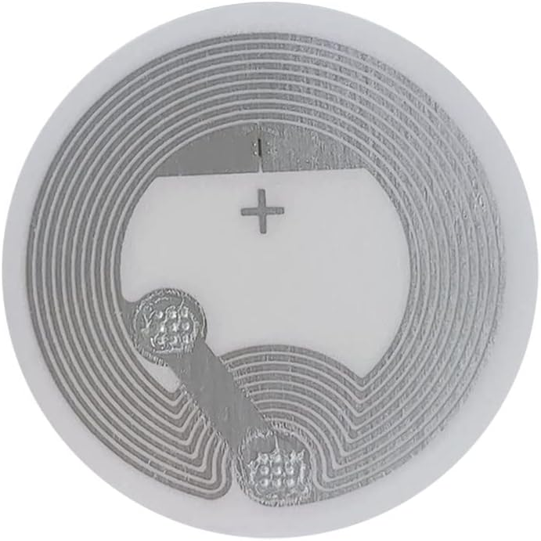
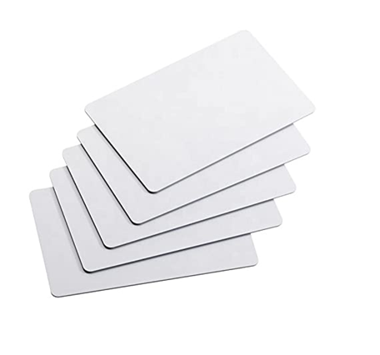
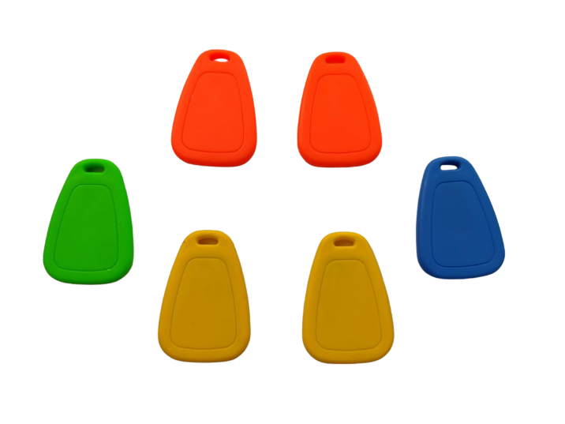
RFID NFC/HF Tags
Aether NFC-27mm
Key Specifications
Chip: NTAG 213
Frequency Band: HF/NFC 13.56Mhz
Dimensions: 27 mm
Label Size : Customisable
Form Factor : Inlays, Labels, Coins
Aether Cards-8550
Key Specifications
Chip: NTAG 213/Mifare 1K/Mifare 4K
Frequency Band: HF/NFC 13.56Mhz
Dimensions: 8550
Printing : Yes
Aether Keychain
Key Specifications
Chip: NTAG 213
Frequency Band: HF/NFC 13.56Mhz
Dimensions: 27 mm
Label Size : Customisable
Form Factor : Inlays, Labels, Coins
7042436155
www.aetherrfid.com

Slide 8
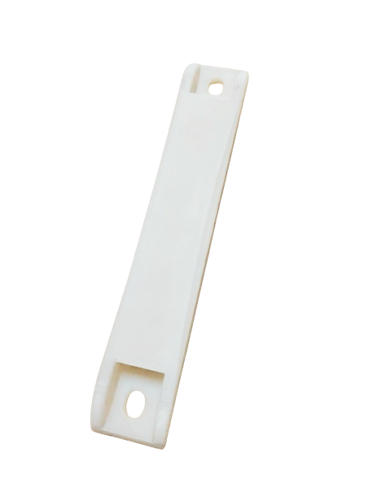
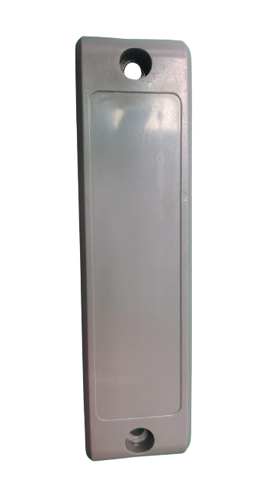
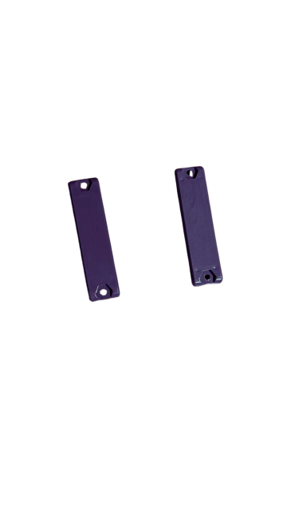
RFID HARD TAGS
Aether RIDGE-15025
Key Specifications
Chip: M730
Frequency Band: UHF 865-867 Mhz
Dimensions: 150X25X15 MM
Personalization : Yes
Out body : ABS
Application : Stick On metal surface, heavy metal tracking
Aether RIDGE-15030
Key Specifications
Chip: M730/Higgs 9
Frequency Band: UHF 865-867 Mhz
Dimensions: 150X30X15 MM
Personalization : Yes
Out body : ABS
Application : Stick On metal surface, heavy metal tracking
Aether RIDGE-5618
Key Specifications
Chip: M730/Higgs 9
Frequency Band: UHF 865-867 Mhz
Dimensions: 56X18X8 MM
Personalization : Yes
Out body : ABS
Application : Stick On metal surface, heavy metal tracking
7042436155
www.aetherrfid.com

Slide 9
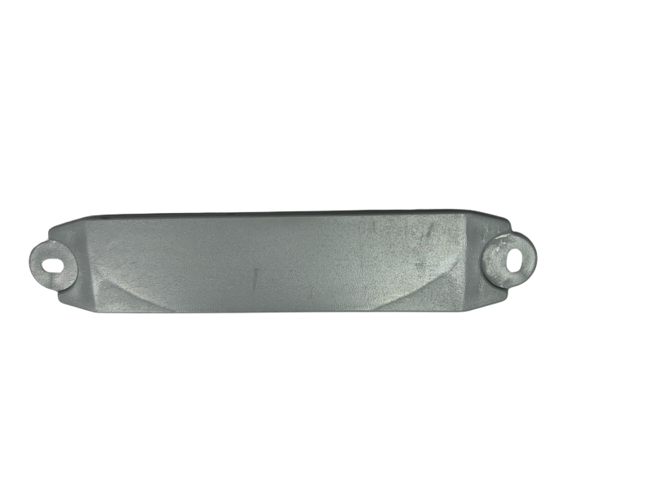
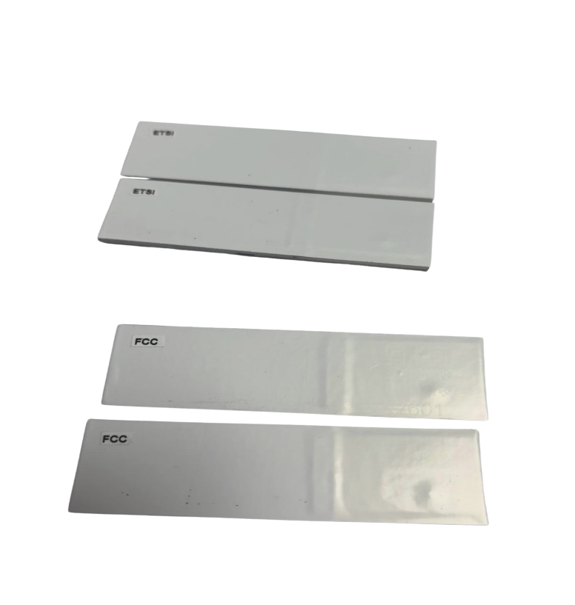
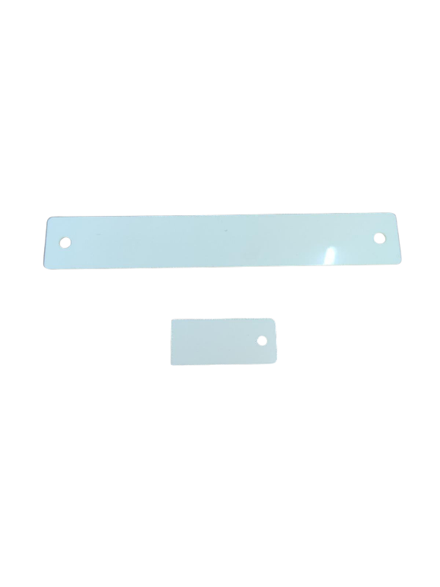
RFID HARD TAGS
Aether RIDGE-11025
Key Specifications
Chip: M730
Frequency Band: UHF 865-867 Mhz
Dimensions: 110X25X8 MM
Personalization : Yes
Out body : ABS
Application : Stick off metal surface, wooden pallet tracking
Aether RIDGE-ACRYLIC
Key Specifications
Chip: M730
Frequency Band: UHF 865-867 Mhz
Dimensions: 70X30X3 MM
Personalization : Yes
Out body : ACRYLIC
Application : Stick off /on metal surface, metal assets
Aether RIDGE-PVC
Key Specifications
Chip: M730
Frequency Band: UHF 865-867 Mhz
Dimensions: 110X25X1 MM
and 40x15x1mm
Personalization : Yes
Out body : PVC
Application : Stick off metal surface, wooden pallet tracking
7042436155
www.aetherrfid.com

Slide 10
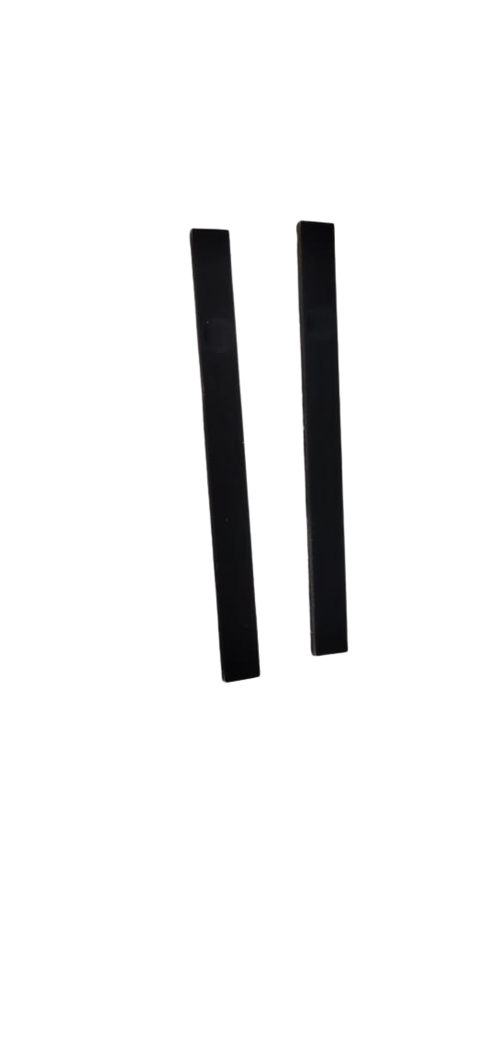

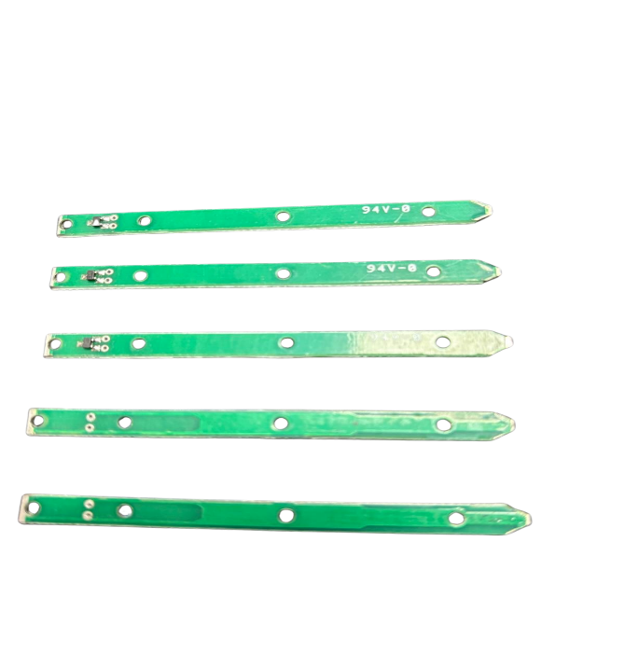
RFID PCB TAGS
Aether RIDGE-PCB-5507
Key Specifications
Chip: HIGSS 3
Frequency Band: UHF 865-867 Mhz
Dimensions: 55X7X3 MM
Personalization : Yes
Out body : PLASTIC
Application : Stick oon metal surface, metal assets, tool tracking
Aether RIDGE-PCB-1307
Key Specifications
Chip: Higss 3/9
Frequency Band: UHF 865-867 Mhz
Dimensions: 13X07X03 MM
Personalization : Yes
Out body : Plastic
Application : Stick oon metal surface, metal assets, tool tracking
Aether RIDGE-PCB-7005
Key Specifications
Chip: M730
Frequency Band: UHF 865-867 Mhz
Dimensions: 70X05X01 MM
Personalization : Yes
Out body : Plastic
Application : Stick oon metal surface, metal assets, tool tracking
7042436155
www.aetherrfid.com

